Slide 1
DSP First, 2/e
Lecture 24
Time-Domain Response
for IIR Systems

Slide 2
License Info for DSPFirst Slides
This work released under a Creative Commons License with the following terms:
Attribution
The licensor permits others to copy, distribute, display, and perform the work. In return, licensees must give the original authors credit.
Non-Commercial
The licensor permits others to copy, distribute, display, and perform the work. In return, licensees may not use the work for commercial purposes—unless they get the licensor's permission.
Share Alike
The licensor permits others to distribute derivative works only under a license identical to the one that governs the licensor's work.
Full Text of the License
This (hidden) page should be kept with the presentation

Slide 3
READING ASSIGNMENTS
This Lecture:
Chapter 10, Sects. 10-9, 10-10, & 10-11
Partial Fraction Expansion

Slide 4
LECTURE OBJECTIVES
Calculate output from Input
Transient and Steady State Responses
Z-Transform method with Partial Fraction Expansion
SECOND-ORDER IIR FILTERS
TWO FEEDBACK TERMS
H(z) can have COMPLEX POLES & ZEROS

Slide 5
CASCADE: Pole-Zero Cancellation
Multiply the z-transforms
x[n]
v[n]
y[n]

Slide 6
What is Frequency Response?
Sinusoid-in gives sinusoid-out
True for LTI systems
Seems to require an infinite-length sinusoid
But, real-world sinusoids start at n=0
With z-transforms, we can solve this one-sided problem

Slide 7
THREE significant INPUTS
Given:
Find the output, y[n]
For 3 cases:

Slide 8
SINUSOID ANSWER
Given:
The input:
Then y[n]

Slide 9
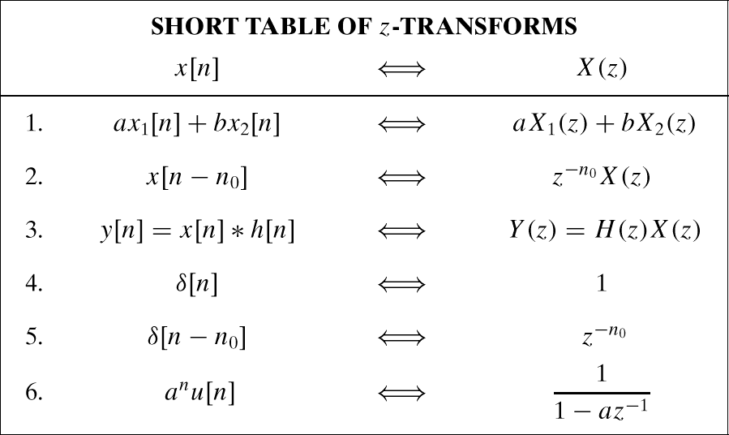
Step Response: u[n]→U(z)

Slide 10
Step Response: x[n] is u[n]
Product
Partial Fraction Expansion
Need Sum of Terms

Slide 11
Step Response
Do the INVERSE
z-Transform of Y(z)
What is DC value of
Frequency Response?

Slide 12
SINUSOID Starting at n=0
Given:
The input:
Then y[n]

Slide 13
SINUSOID Starting at n=0

Slide 14
SINUSOID Starting at n=0
Transient
Steady-State

Slide 15
BONUS QUESTION
Given:
The input is
Then find y[n]

Slide 16
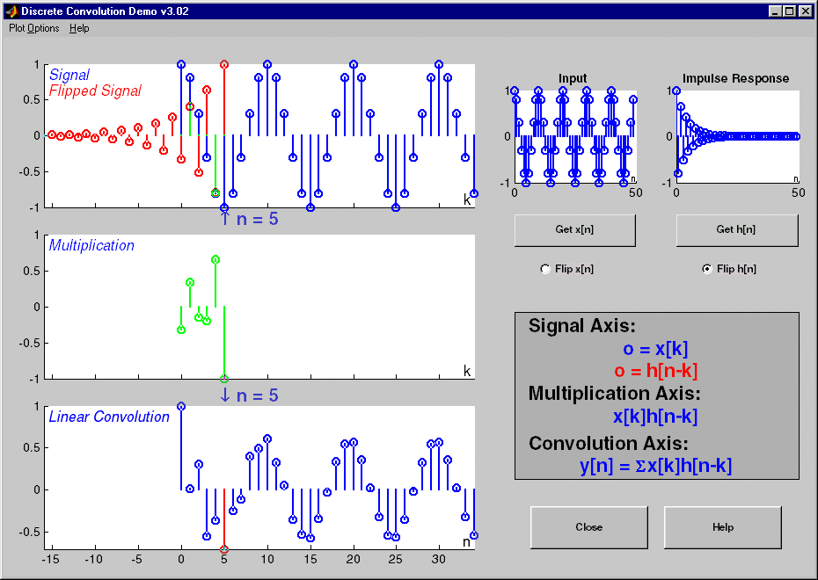
Transient & Steady State

Slide 17
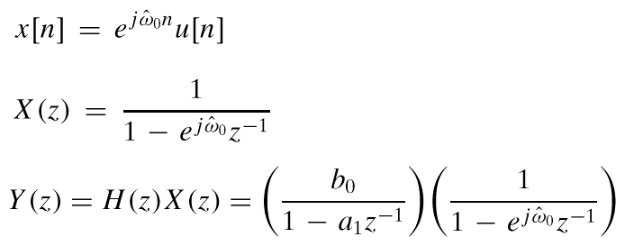
CALCULATE the RESPONSE
Use the Z-Transform Method
And PARTIAL FRACTIONS

Slide 18
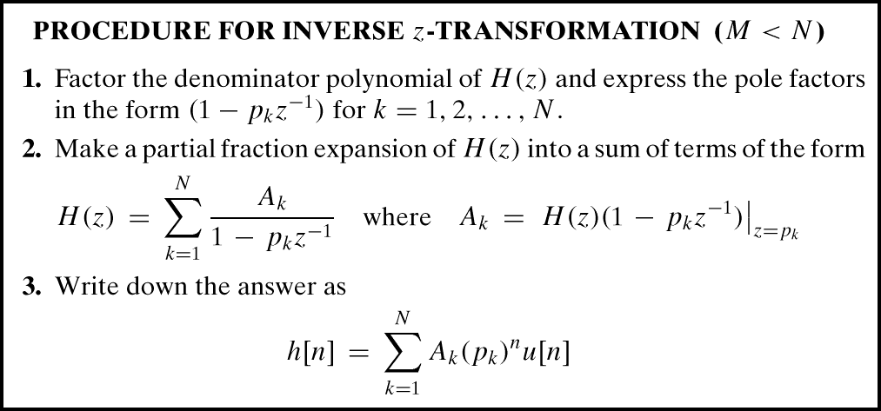
GENERAL INVERSE Z
(pole)^{n}

Slide 19
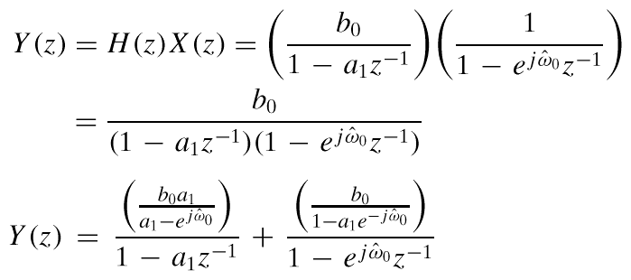
SPLIT Y(z) to INVERT
Need SUM of Terms:

Slide 20
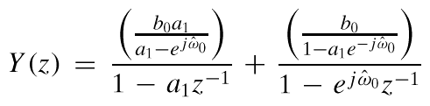

INVERT Y(z) to y[n]
Use the Z-Transform Table

Slide 21
TWO PARTS of y[n]
TRANSIENT
Acts Like (pole)^{n}
Dies out ?
IF |a₁|<1
STEADY-STATE
Depends on the input
e.g., Sinusoidal

Slide 22
STEADY STATE HAPPENS
When Transient dies out
In the Limit as “n” approaches infinity
Can use Frequency Response to get Magnitude & Phase for sinusoid

Slide 23
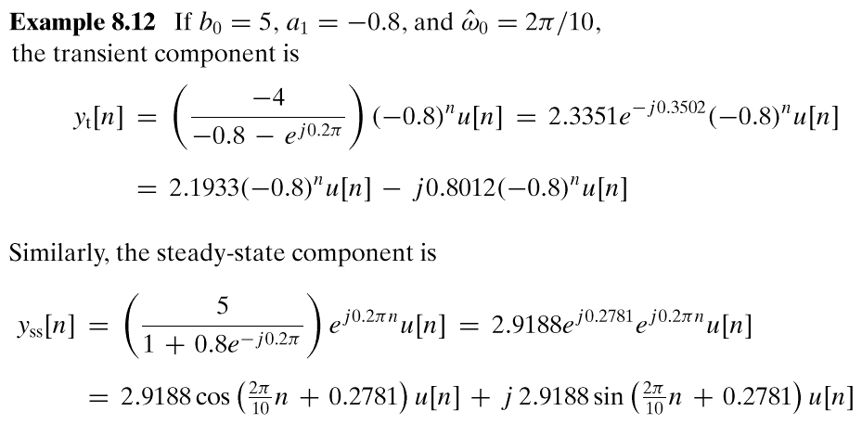
NUMERICAL EXAMPLE

Slide 24
SINUSOID starting at n=0
We’ll look at an example in MATLAB
x[n]=cos(0.2πn)u[n]
Pole at –0.8, so a^{n} is (–0.8) ^{n}
There are two components:
TRANSIENT
Start-up region just after n=0; (–0.8) ^{n}
STEADY-STATE
Eventually, y[n] looks sinusoidal.
Magnitude & Phase from Frequency Response

Slide 25
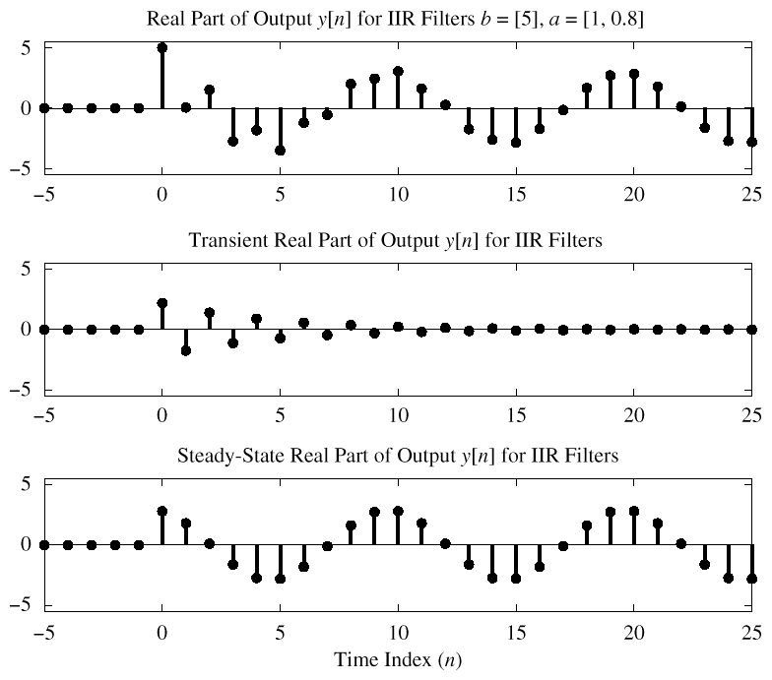
Cosine input

Slide 26
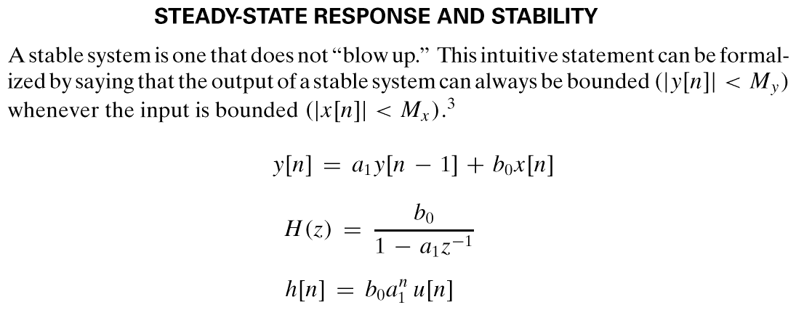
STABILITY
When Does the TRANSIENT DIE OUT ?

Slide 27
Stability
Nec. & suff. condition:
Pole at z=a must be
Inside unit circle

Slide 28
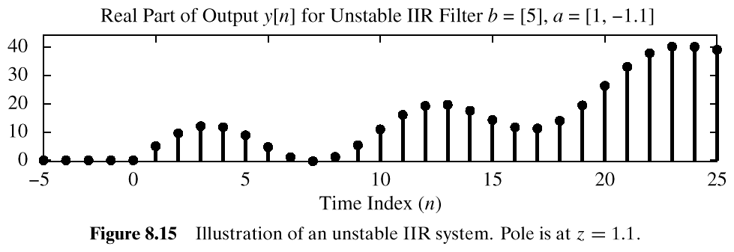
STABILITY CONDITION
ALL POLES INSIDE the UNIT CIRCLE
UNSTABLE EXAMPLE:
POLE @ z=1.1

Slide 29
SECOND-ORDER FILTERS
Two FEEDBACK TERMS

Slide 30
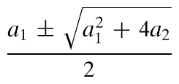
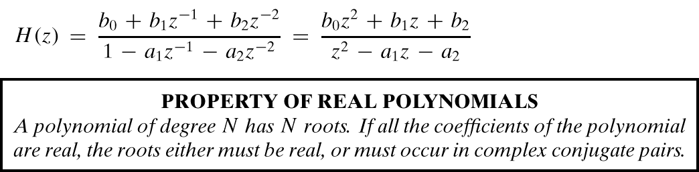
MORE POLES
Denominator is QUADRATIC
2 Poles: REAL
or COMPLEX CONJUGATES

Slide 31
TWO COMPLEX POLES
Find Impulse Response ?
Can OSCILLATE vs. n
“RESONANCE”
Find FREQUENCY RESPONSE
Depends on Pole Location
Close to the Unit Circle?
Make BANDPASS FILTER

Slide 32
Inverse z-Transform?
SECOND-ORDER IIR FILTERS
H(z) can have COMPLEX POLES & ZEROS

Slide 33
2nd ORDER z-Transform

Slide 34
2nd ORDER Z-transform PAIRS
GENERAL ENTRY for
z-Transform TABLE

Slide 35
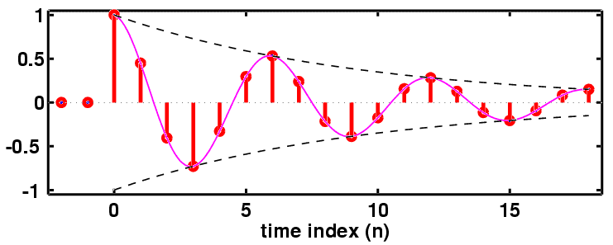
h[n]: Decays & Oscillates
“PERIOD”=6

Slide 36
2nd ORDER EX: n-Domain
aa = [ 1, -0.9, 0.81 ];
bb = [ 1, -0.45 ];
nn = -2:19;
hh = filter( bb, aa, (nn==0) );
HH = freqz( bb, aa, [-pi,pi/100:pi] );

Slide 37
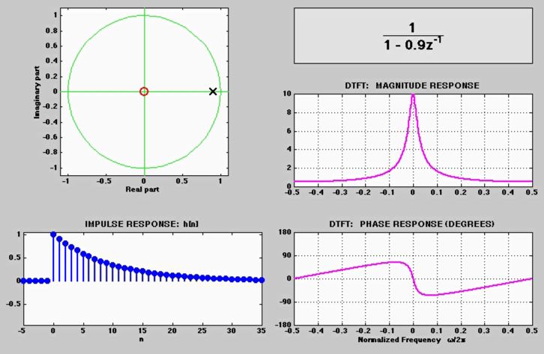
3 DOMAINS MOVIE: IIR
H(z)
POLE MOVES
h[n]

Slide 38
7 IIR MOVIES @ WEBSITE
http://dspfirst.gatech.edu/chapters/08feedbac/demos/3_domain/index.html
3 DOMAINS MOVIES: IIR Filters
One pole moving and a zero at the origin
One pole and one zero; both moving
Two complex-conjugate poles moving radially
Two complex-conjugate poles moving in angle
Movement of a zero in a two-pole Filter
Radial Movement of Two out of Four Poles
Angular Movement of Two out of Four Poles

